Slide 1

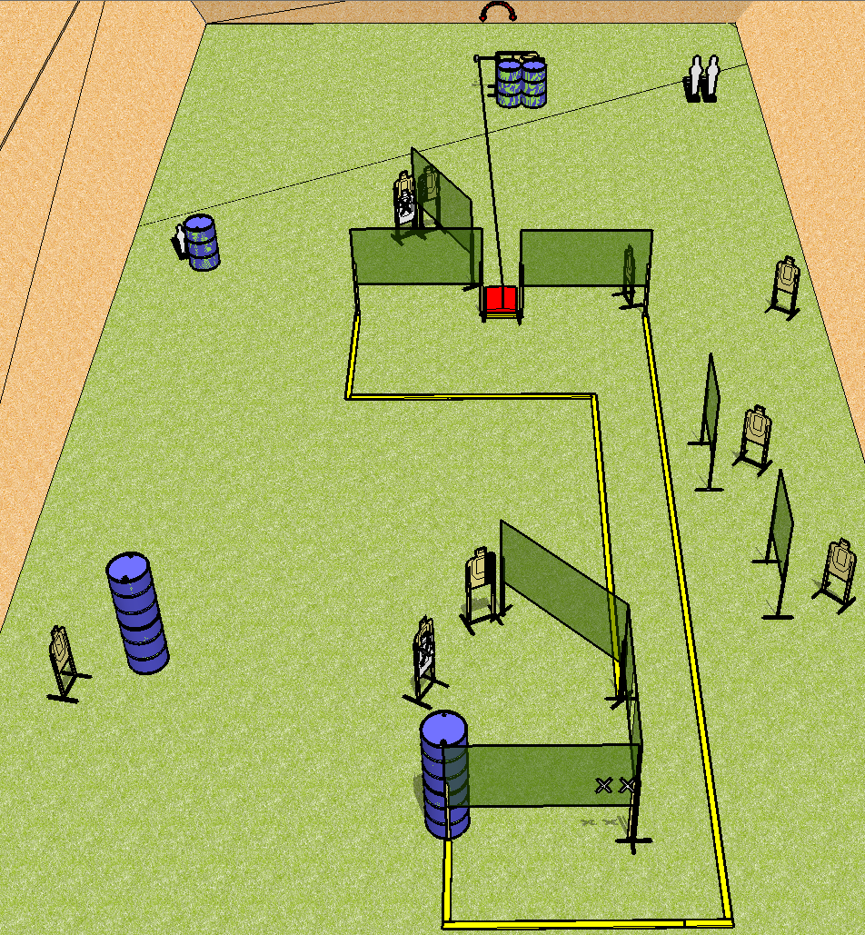
 | Dothan Practical Shooters – USPSA Match Curve Crush Course Designer : Andrew Hobbs Bay: A1
Round Count 23 rounds 10 USPSA 2 colts poppers, 1 mini popper
Equipment List 15 wall feet Stomp pad + swinger 1 right HC, 1 left HC 10 targets (8 + 2NS)

Slide 2
Curve Crush
Written Stage Briefing
Scoring: Comstock Rounds: 23
Targets: 10 USPSA, 3 steel
Handgun start position: hands touching marks. Handgun is unloaded and holstered.
PCC start position: muzzle touching mark, stock on belt. Unloaded carbine is held with both hands.
Stage Procedure: on the audible start signal, engage targets as they become available from within the shooting area. The swinger is activated by the stomp pad and remains visible at rest.

